Slide 1

Indian Institute of Technology , Patna
Topic : Activation functions
Presented By :
Rutuj Waghare (2111MC10)
M.Tech – Mathematics and Computing
Guided By :
Dr. Prashant Srivastava
Associate Professor
Department of Mathematics
[1]

Slide 2
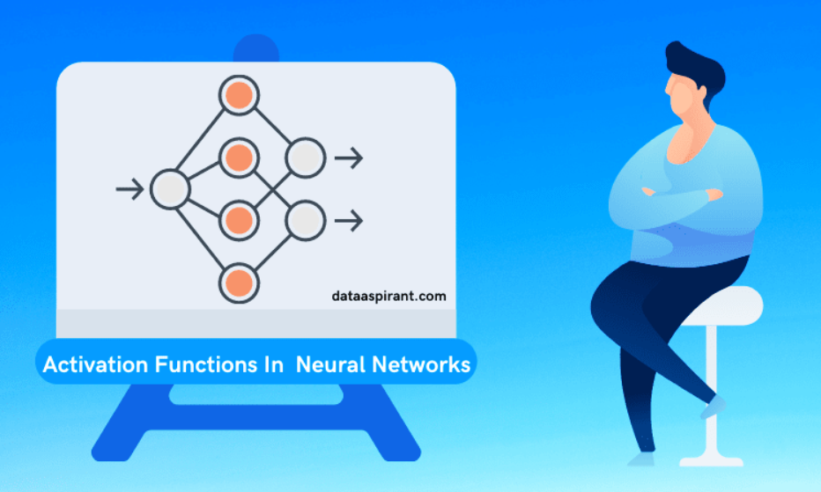
What is Activation function ?
[2]
source : dataaspirant.com

Slide 3
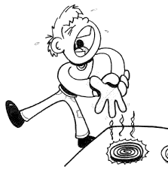
What is Activation function ?
[2]
source : medium.com

Slide 4
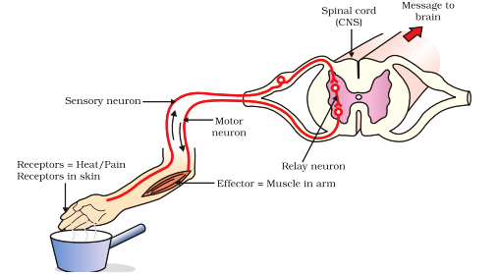
What is Activation function ?
[2]
source : socratic.org

Slide 5

Why is there need of it ?
[3]
source : pixabay.com

Slide 6
Activation function helps in keeping the value of the output from the neuron restricted to a certain limit as per our requirement.
This is important because input into the activation function is W*x + b where W is the weights of the cell and the x is the inputs and then there is the bias b added to that.
This value if not restricted to a certain limit can go very high in magnitude especially in case of very deep neural networks that have millions of parameters.
This will lead to computational issues.
[4]

Slide 7
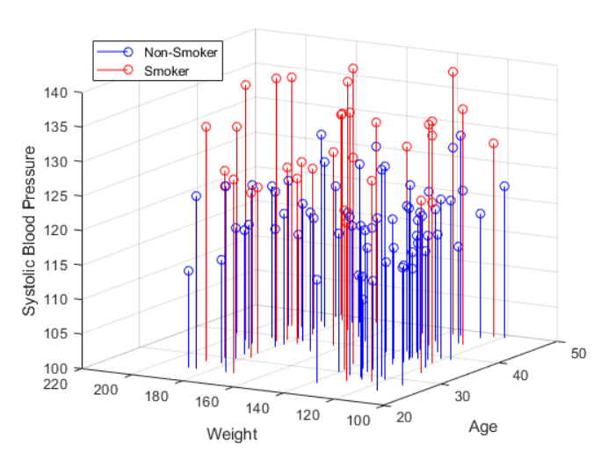
The most important feature in an activation function is its ability to add non-linearity into a neural network.
[5]

Slide 8
Properties of Activation functions
Computationally Inexpensive
Differentiable
Zero Centered
[6]

Slide 9
Properties of Activation functions
Computationally Inexpensive
The activation function computation has to be very minimal, as this impacts the neural network training period.
If the activation functions are computational high, it will take a lot of time for getting the optimized weights at each layer in the network.
[7]

Slide 10
Properties of Activation functions
Differentiable
to learn the complex patterns in the training data, the activation functions need to be differentiable.
[8]

Slide 11
Properties of Activation functions
Zero Centered
Output of the activation function should be symmetrical at zero so that the gradients do not shift to a particular direction.
[9]

Slide 12
Categories of Activation functions
Binary step function
Activation Functions
Linear activation function
Non - Linear activation function
[10]

Slide 13
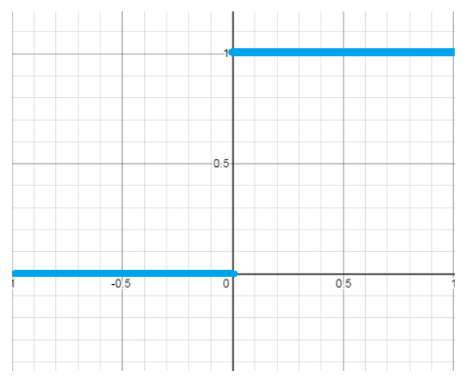
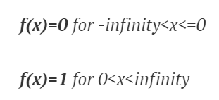
Binary Step function
[11]
source : afteracademy.com

Slide 14
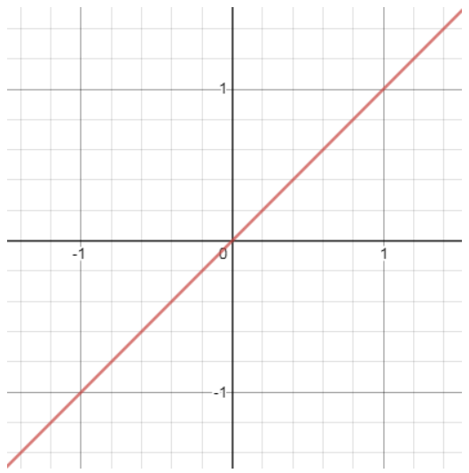

Linear activation function
[12]
source : afteracademy.com

Slide 15
References
[1] https://towardsdatascience.com/everything-you-need-to-know-about-activation-functions-in-deep-learning-models-84ba9f82c253 [Accessed on 23 Jan 2022 ]
[2] https://medium.com/the-theory-of-everything/understanding-activation-functions-in-neural-networks-9491262884e0 [Accessed on 23 Jan 2022 ]
[3] https://towardsdatascience.com/activation-functions-neural-networks-1cbd9f8d91d6 [Accessed on 23 Jan 2022 ]
[4] https://afteracademy.com/blog/mastering-activation-functions-in-neural-networks [Accessed on 24 Jan 2022 ]
[5] https://dataaspirant.com/popular-activation-functions-neural-networks/
[Accessed on 24 Jan 2022 ]
[13]

Slide 16
Thank You.
[14]

